Slide 1

Project Management System Manipal University Jaipur
Minor project END TERM presentation
Batchelor of Engineering
2018-2020
By Vinayak Vyas
IT-6C 189302119
in the guidance of Dr Ashish jain

Slide 2
Introduction
The Project management system is simply designed and built for the convenience of the faculties and students .
The need for this system arrives when we as a faculty or student start exploring the mentors and their guided projects .This is a convenient web application for opting for projects , contacting mentors , applying for the slots & eases the physical process of approaching or calling mentors randomly .

Slide 3
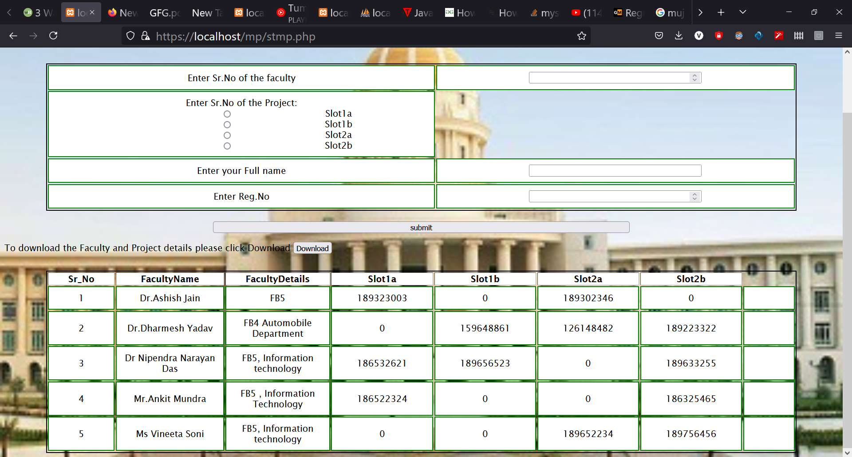
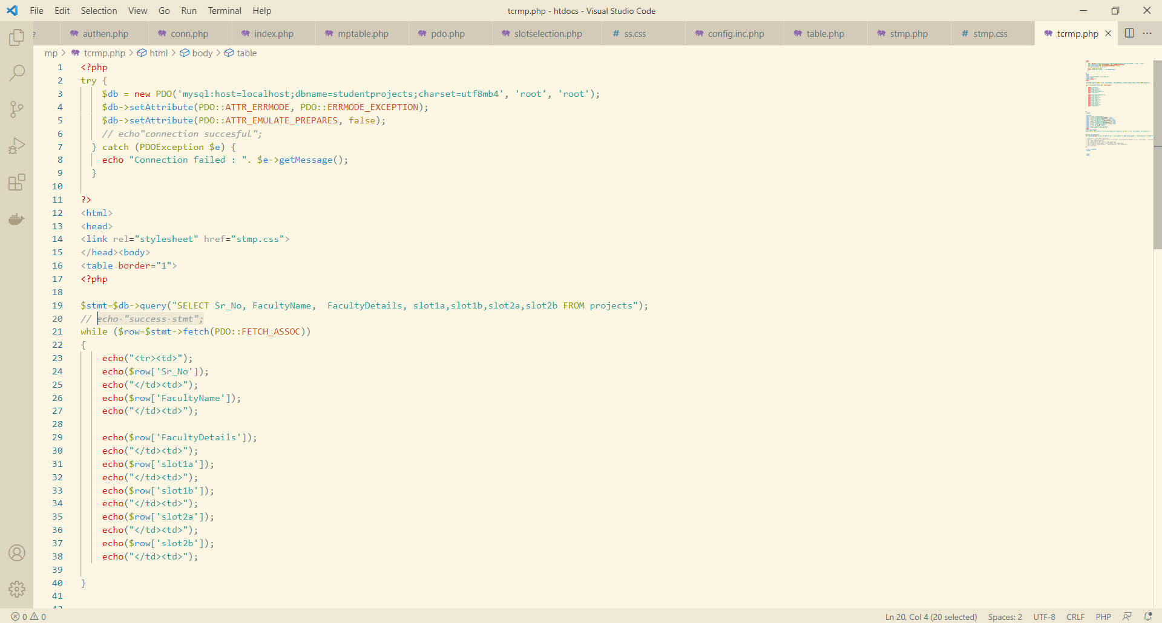
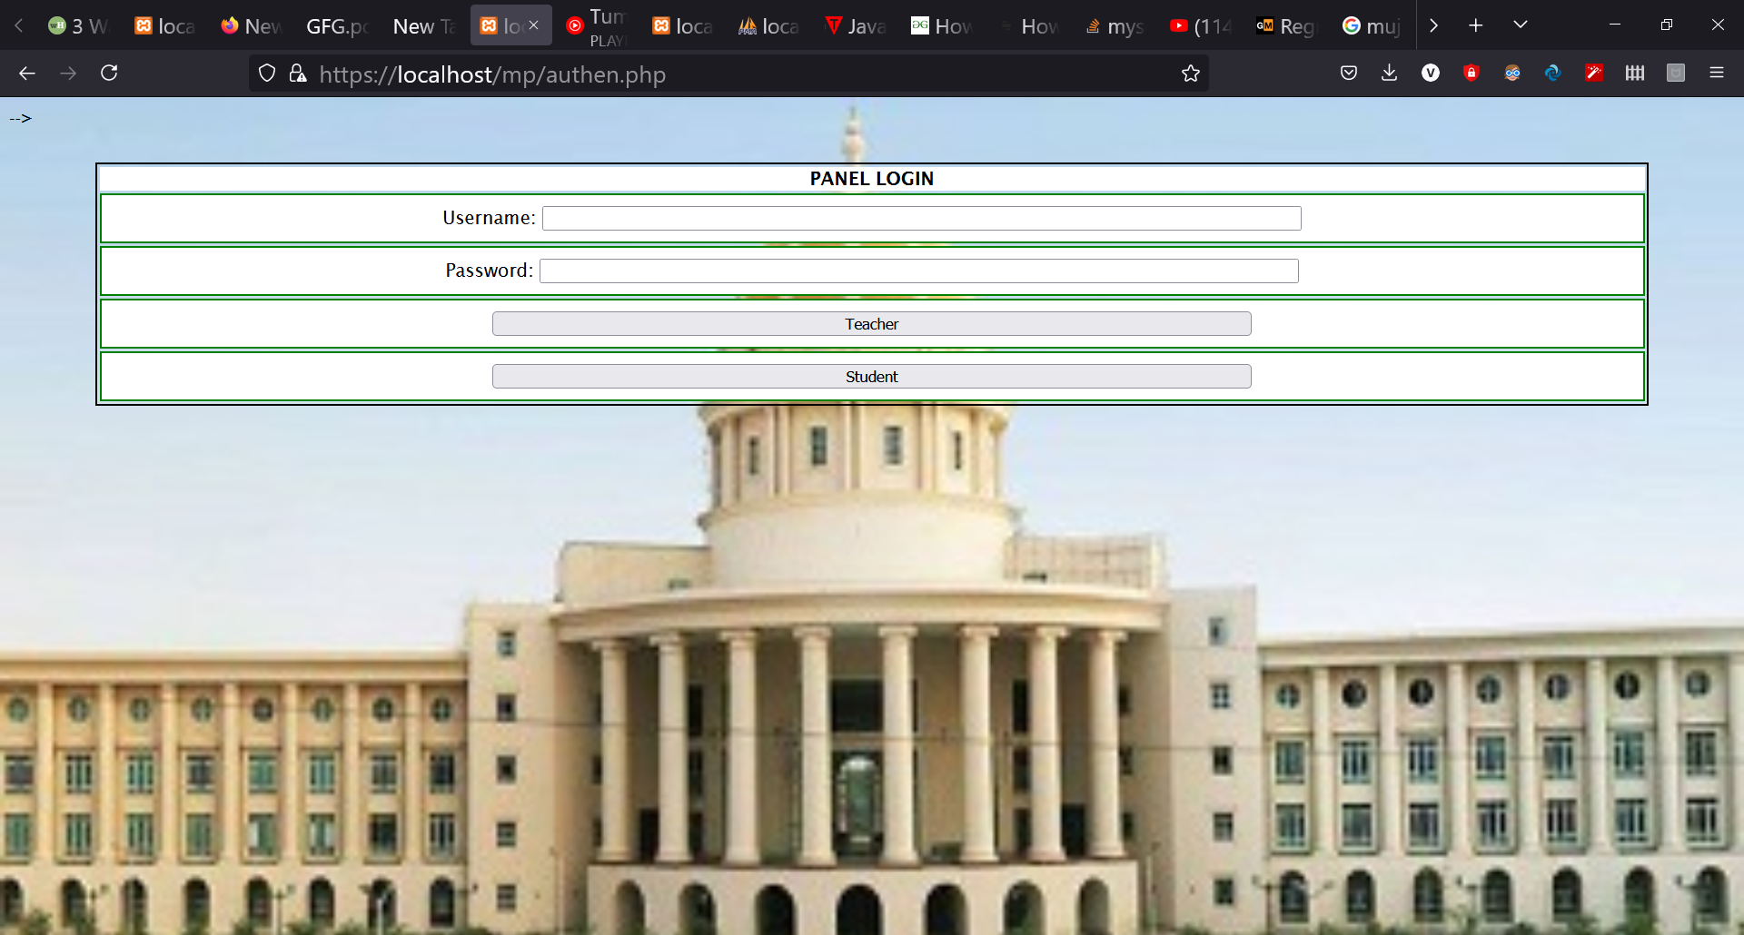
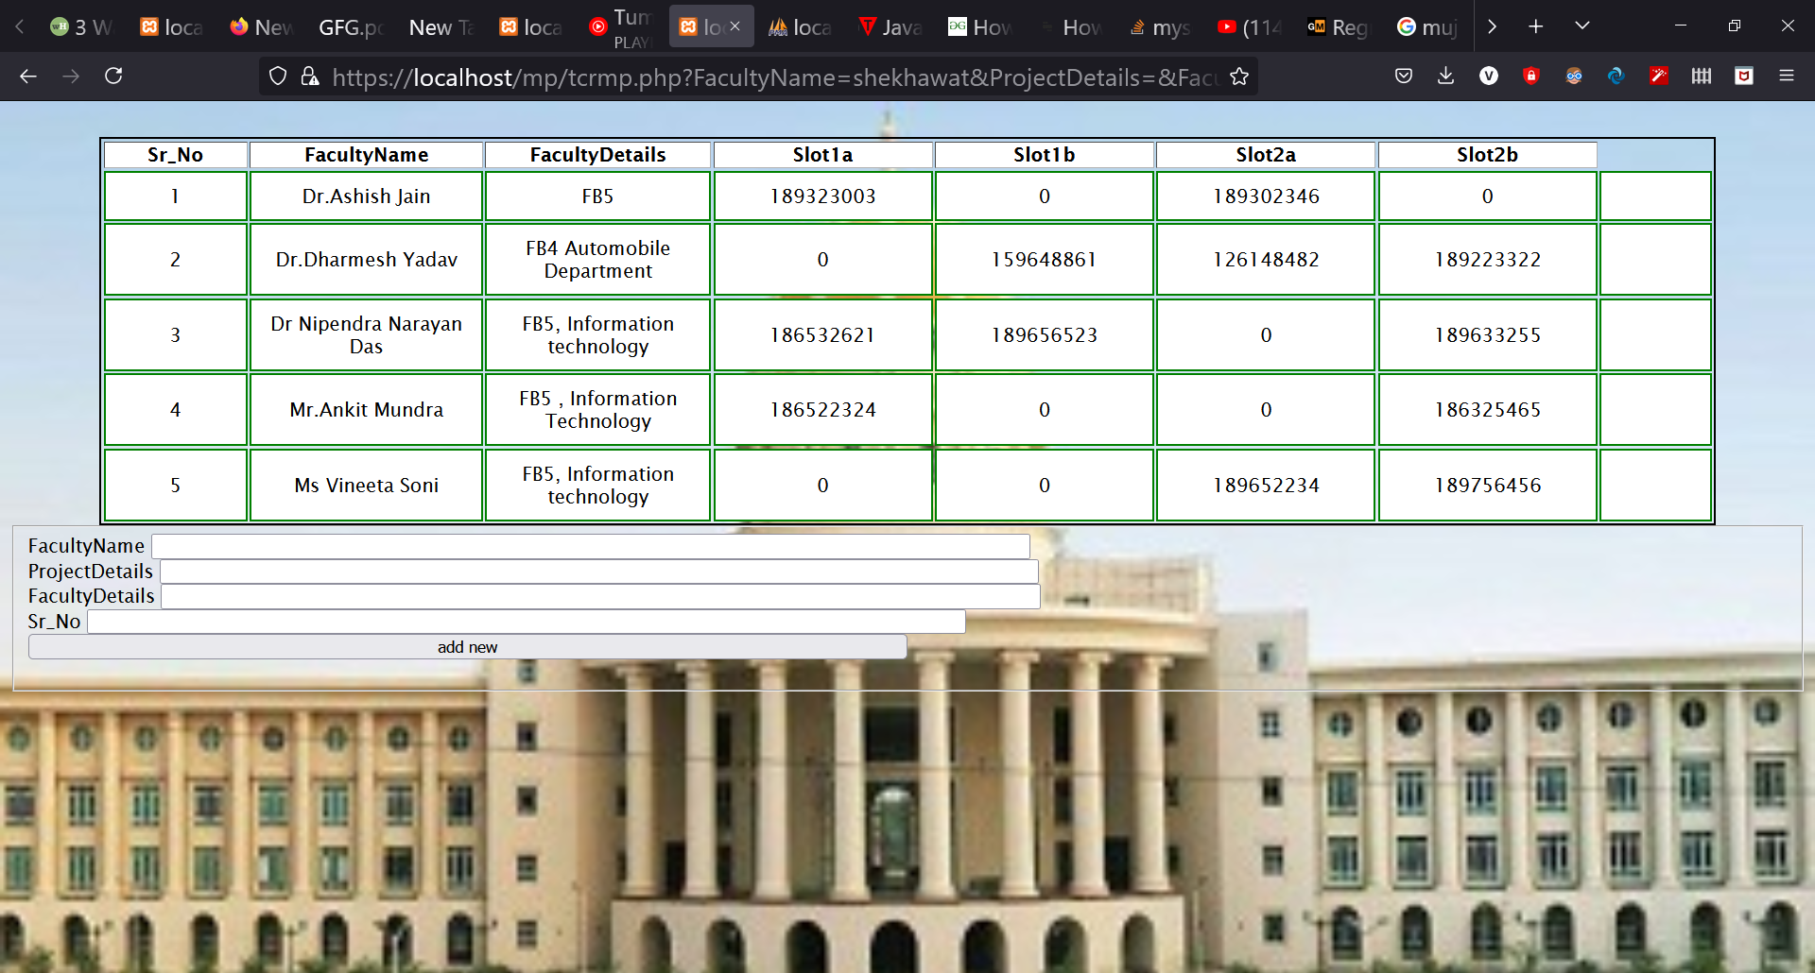

Slide 5
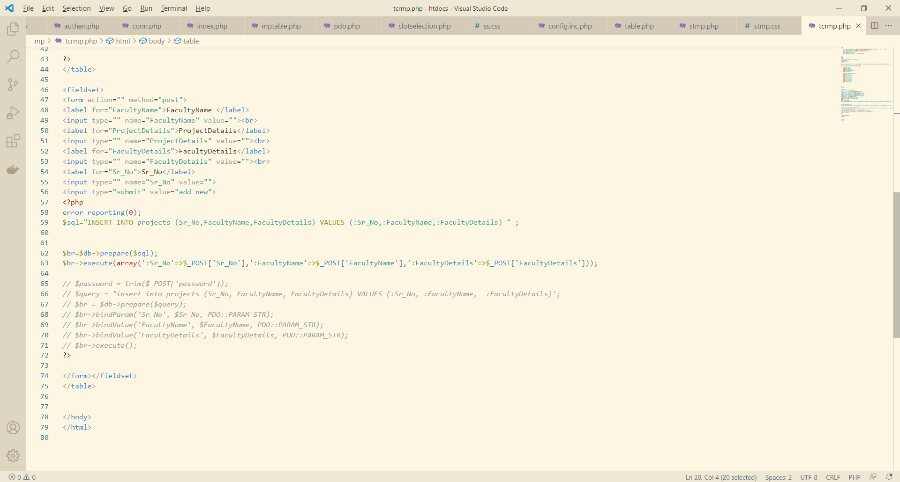

Slide 7
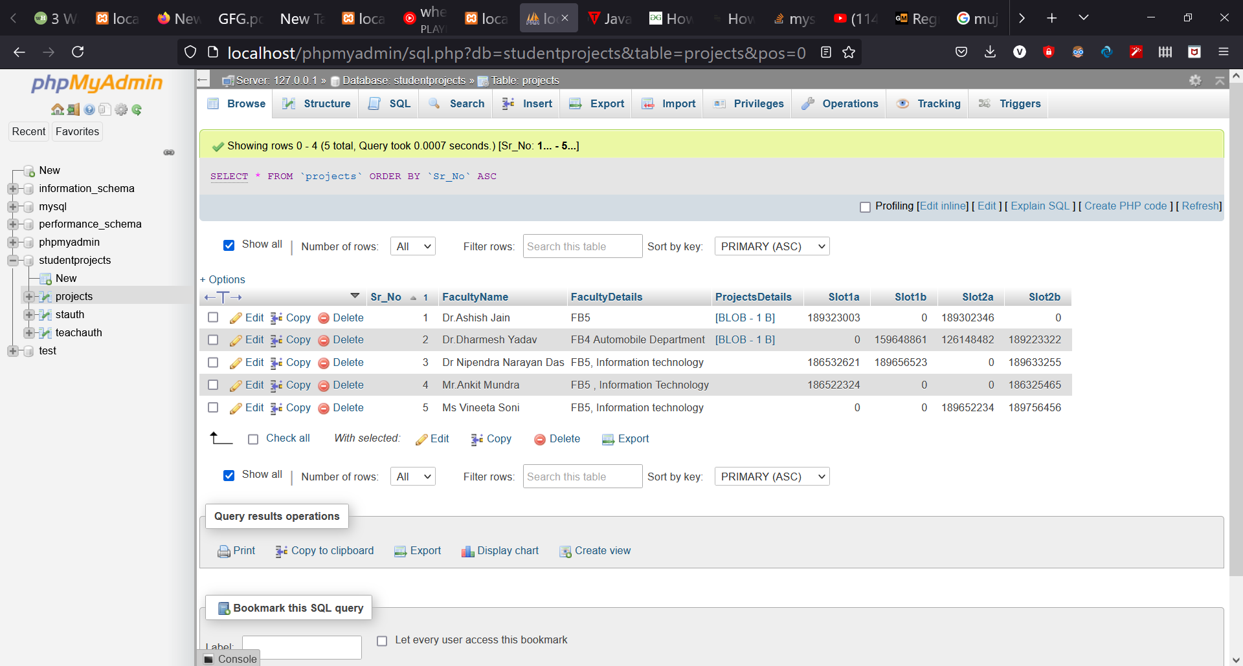

Slide 8
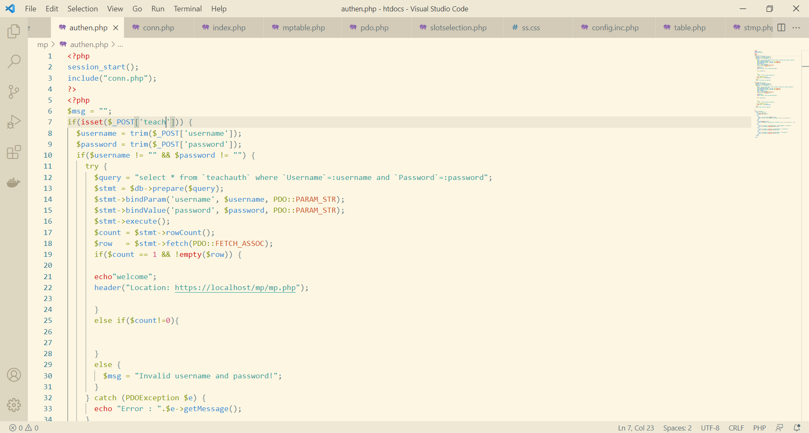

Slide 9
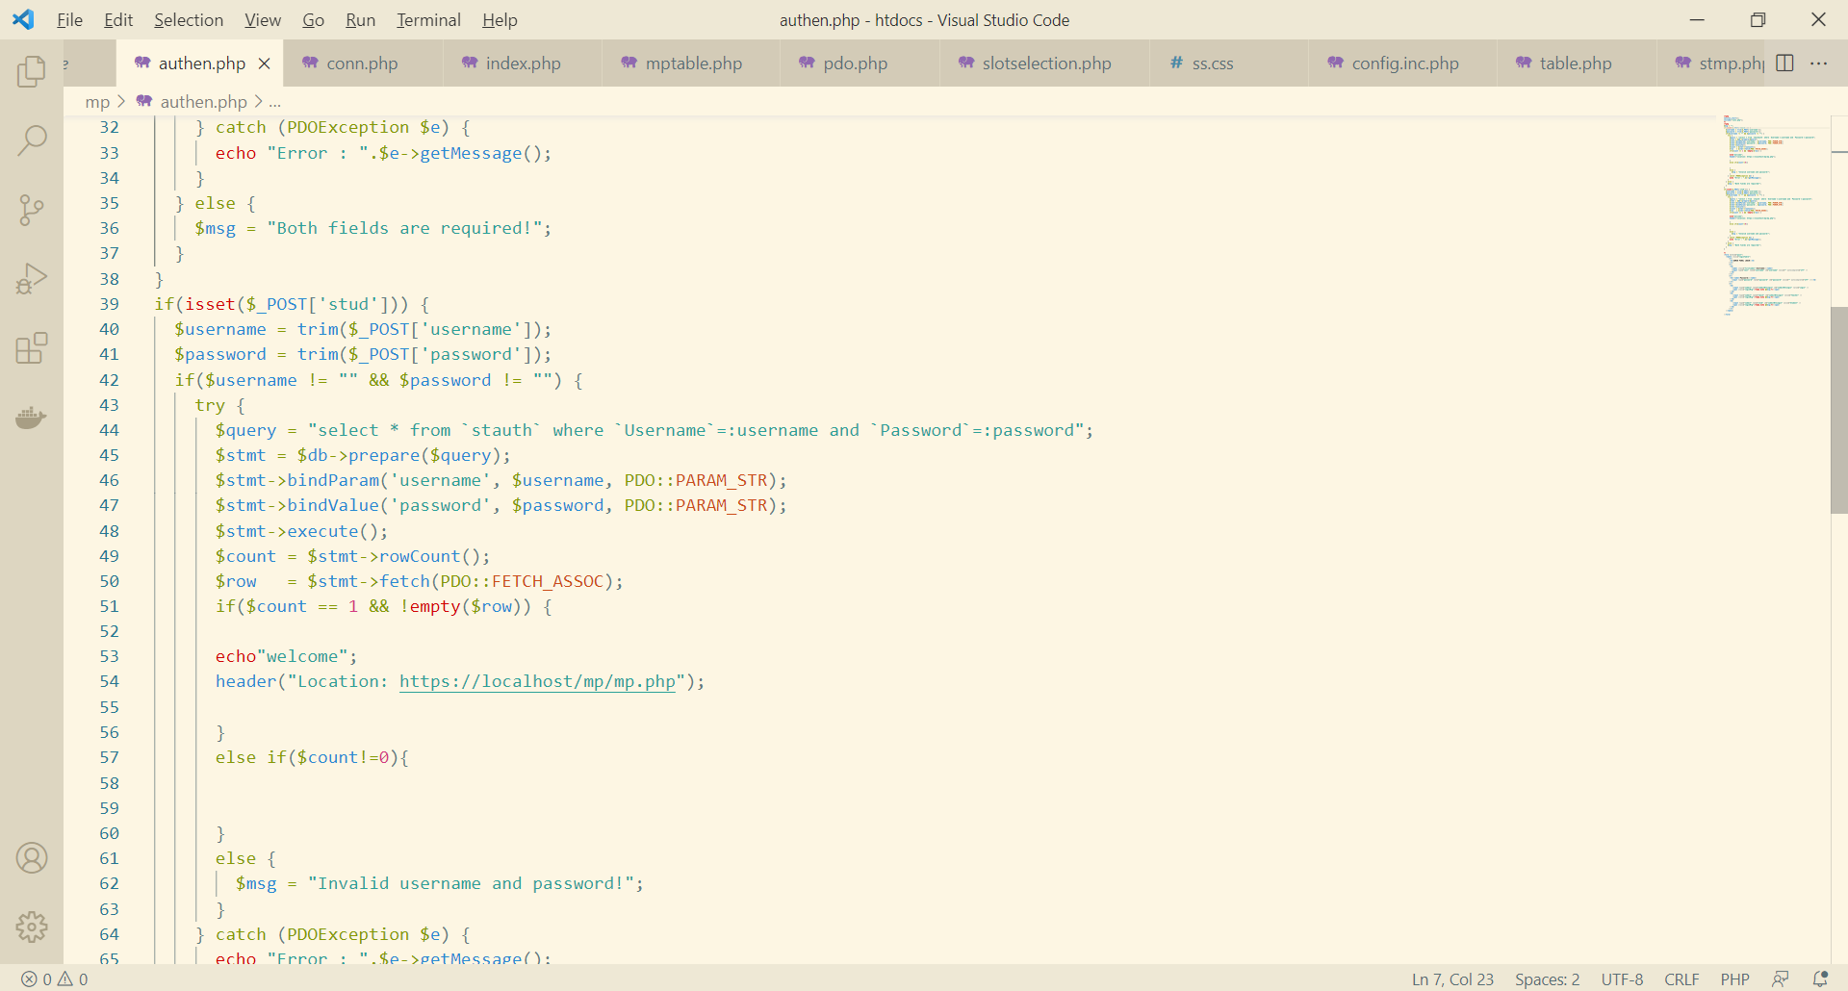

Slide 10
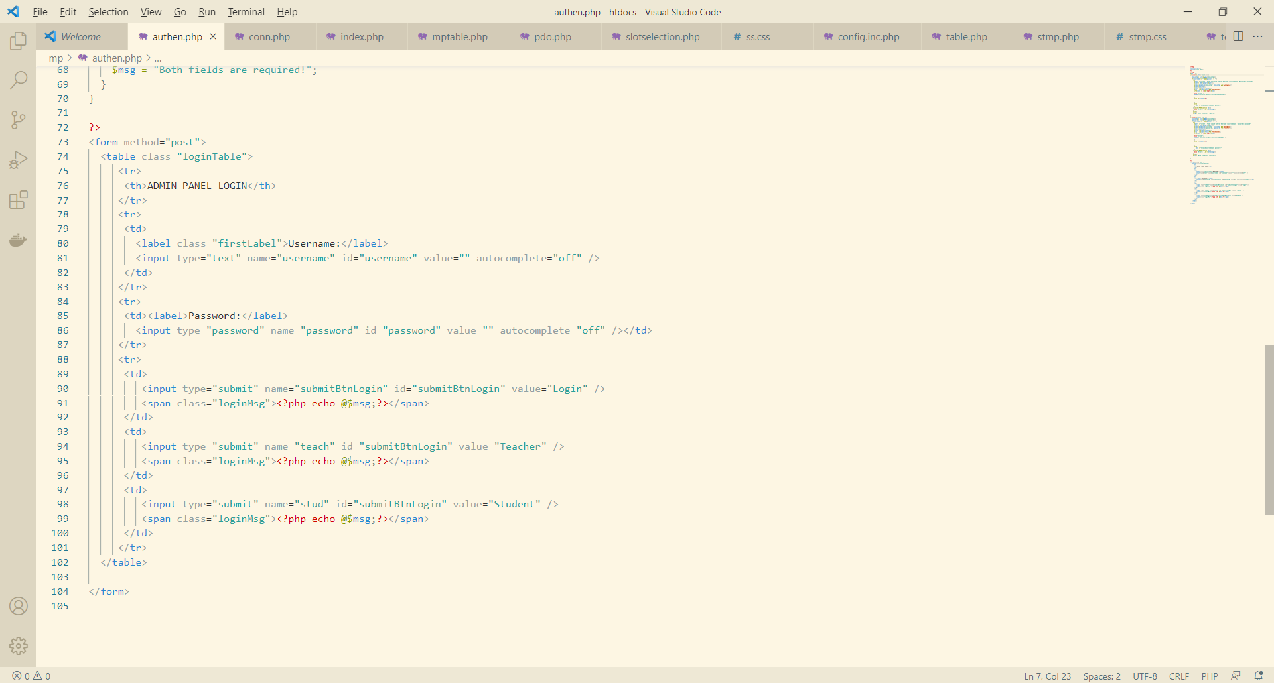

Slide 12
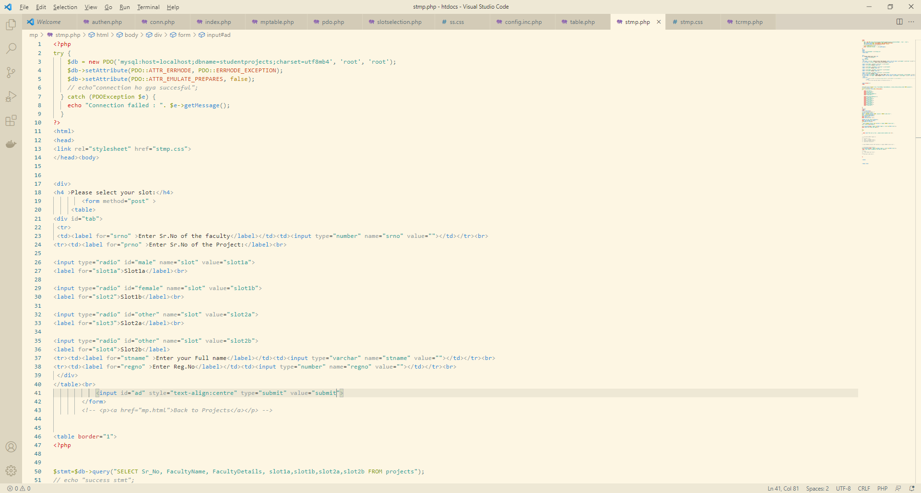

Slide 13
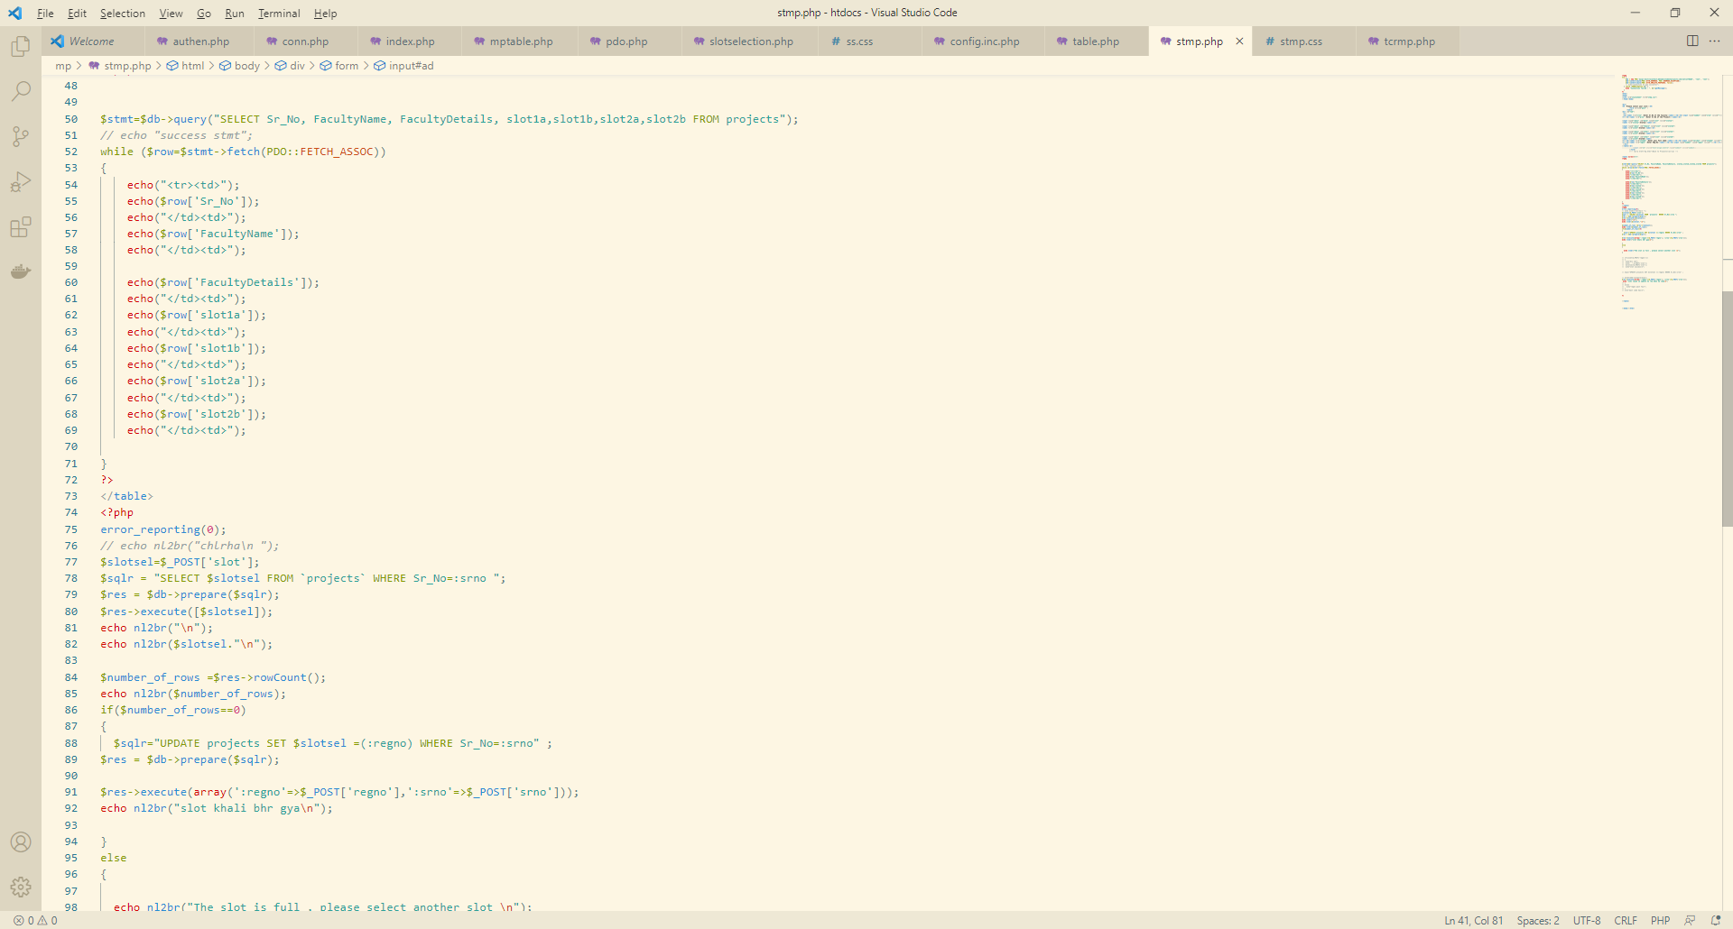

Slide 14
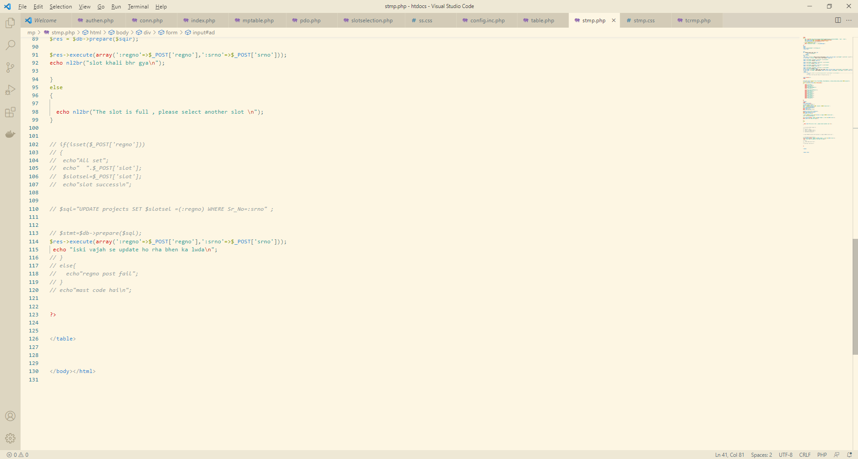

Slide 15
Conclusion
The project will helped me learn the request respond cycle of the whole web network
It will help me learn both front end and backend side development.
This project is a time saver add on which is required in the modern tech era.
It can be very helpful add on to an organisation or institution in management.

Slide 16
Thank you.

